Slide 1

Job Application and CV
How to write an application for a job?

Slide 2
Job Application (Letter)
Heading
Inside Address
Subject (Optional)
Salutation
Body (Opening; Message; Closing)
Subscription
Signature (Handwritten) and Name
The Enclosure
Carbon Copy (Cc.)

Slide 3
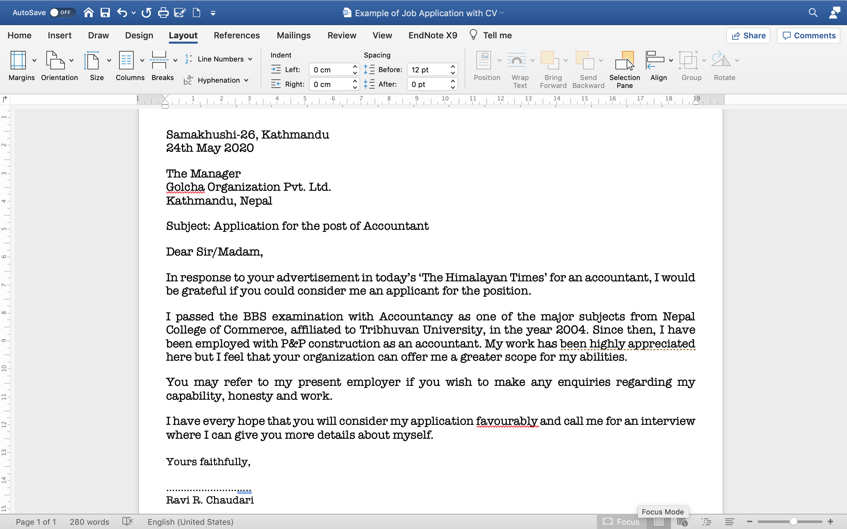

Slide 4
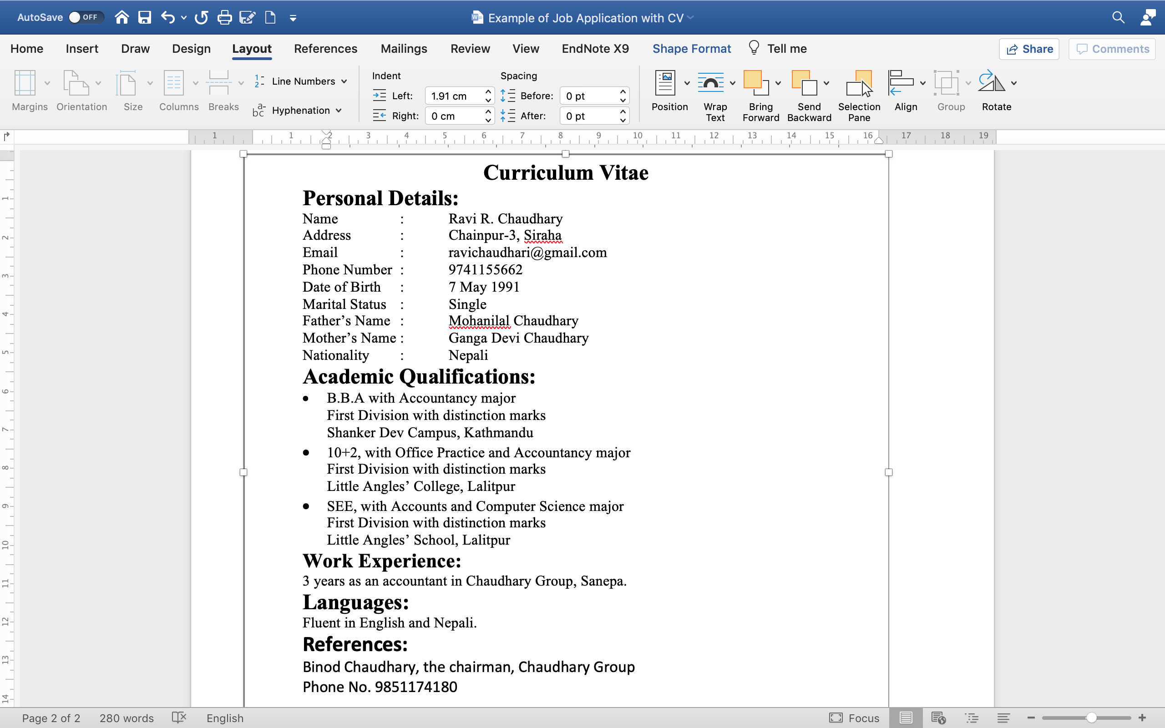

Slide 5
Keep things in mind
While writing a job application, mind who is to be addressed
Mainly focus on: Opening, Message and Closing.

Slide 6
Opening can be:
With reference with your advertisement which was published in The Kathmandu Post on…, I would like to present my candidacy for the same post.
Having been informed through the advertisement recently published that your school requires…, I have the honour to apply for the post.
I am writing in response to the advertisement published in...
In response to the advertisement published in The Himalayan Times dated on …., I wish to submit my candidacy for the post of…

Slide 7
Message:
Mention personal details, experiences, special skills and your commitment and assurance in the message.
Personal Details: I am a young energetic man of 25. I have passed BBS from TU with distinction division….
Experiences: After I completed my bachelor degree, I have been working as an accountant in a reputed organization since last three years….
Special Skills: I have had the trainings on how to deal with customers
Commitment and Assurance: If I am given an opportunity to serve your organization, I assure you that I will try my best to satisfy you with best work.

Slide 8
Closing cab be:
I am looking forward to hearing positive response.
I am looking forward to receiving your phone call for interview.
Looking forward to getting your favourable response.

Slide 9
Read the following ad. and write an application.
WANTED URGENTLY
An NGO working in the field of technical education based in Kathmandu requires a young, energetic person for the post of office assistant. If you think you deserve the post, apply to: The Director, GPO Box 1343, Kathmandu Nepal
Min. qualification: at least SEE with accountancy.
Computer Knowledge: proficient in Ms- office package. Interested candidate must apply with her/his CV by 3rd December.

Slide 10
Curriculum Vitae
It is a short written description of your education, qualifications, previous jobs, and sometimes also your personal interests, that you send to an employer when you are trying to get a job.
CV, Vitae, Résumé

Slide 11
It is the summary of your work history and education.
It should convince a potential employer that you are an outstanding candidate for the job and that you will contribute to the organization.
To prepare a successful CV, you need to know how to:
summarize, and
present your experiences and achievements on one page.
Outline your achievements briefly and concisely.

Slide 12
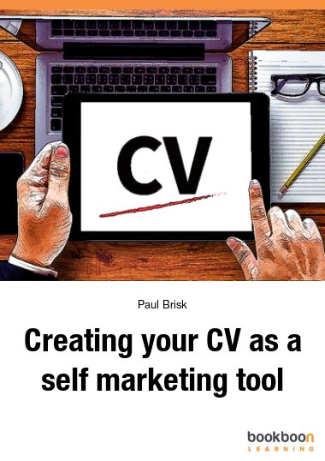

Marketing tool
Advertising self

Slide 13
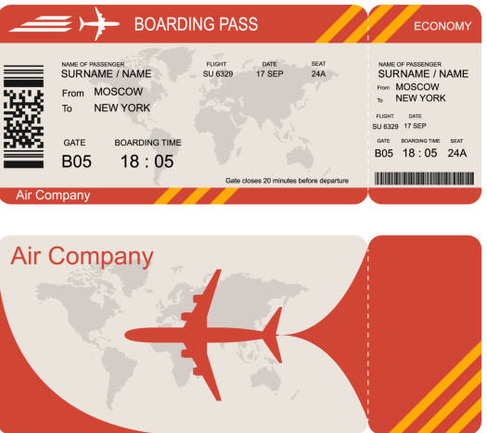
Ticket to an interview.

Slide 14
It should include:
Personal Data/Information
Name
Address (Permanent and Correspondence)
Contact No
Email ID
Date of Birth
Nationality
Marital Status
Sex
Religion
Career objective:
Refers to the ultimate aim/goal of an applicant.
Be careful that the objective and the post for which the applicant is applying for should match.

Slide 15
Education/Academic Qualification:
Shows the academic degrees received by the applicant
Mention the educational information both in chronological and reverse chronological order.
Better follow the reverse chronological order.
Include degree, passed year, Examination Board/University, Major Subjects, Percentage/Grade/Division
Employment History/Work Experience:
Mention the list of the related works done in the past
Better follow the reverse chronological order for
Include:
the time period you worked for
the job title/position
the name and address of the organization/institution
the major duties and responsibilities

Slide 16
Additional Information:
Publications
Awards
Interests/Hobbies
Computer Skills/Trainings
Languages
References:
It is a source of recommendation of the applicant.
Mention the names with position and address of the individuals or officials

Slide 17
Types of CV
Resumes can be written in different ways as per the requirements.
Resumes
Functional
It just lists down the qualification and work experience without any chronological order.
It focuses on ‘what’ rather than ‘when’.
Chronological
This is written in reverse order with the latest job first and the first job at the last followed by educational qualification with highest degree first.

Slide 18
CURRICULUM VITAE
Personal Details:
Name: Richard Stanley Wilton
Address: 64 Arundel Road,
Tel: 0642-916216
Bradford W. Yorks
BL 48 NW
Date of Birth: 4 December 1960
Nationality British
Marital Status: Single
Present Occupation: Photographer for Wild Life Magazine
Education/Academic Qualification:
June 1976 | G.C.E. O Level | English, Maths, Physics, Chemistry, Geography
June 1978 | G.C.E. A Level | Geography, Maths
Hye 1982 | B. Sc. | Computer Science

Slide 19
Experience:
Languages: French-Fair Greek-Good
Hobbies Cinema, Politics
Sports: Tennis, swimming, football, cricket and volleyball
Reference:
Mrs. James Francome
21 Manor Road, London SE 14, UK
(Tutor at Polytechnic)
Mrs. Jane Wilson
Wild Life Magazine
17-21 Queen Street, Brandfort W. Yorks, UK
(Editor of Magazine)
Summer 1980-1981 | Worked as Camp Assistant in Brinton’s Holiday Camp Lowestoft, U.K.
1982-1985 | Computer Programmer, Blaxi Chemicals, Luton, UK.
1986-1987 | Travel Guide, Grecotours Ltd. Athens, Greece
1987-Present | Photographer, Wild Life Magazine

Slide 20
CURRICULUM VITAE
Personal Details:
Name: Richard Stanley Wilton
Address: 64 Arundel Road,
Tel: 0642-916216
Bradford W. Yorks
BL 48 NW
Date of Birth: 4 December 1960
Nationality British
Marital Status: Single
Present Occupation: Photographer for Wild Life Magazine
Education/Academic Qualification:
June 1976 | G.C.E. O Level | English, Maths, Physics, Chemistry, Geography
June 1978 | G.C.E. A Level | Geography, Maths
Hye 1982 | B. Sc. | Computer Science

Slide 21
Any Queries?

Slide 22


